Slide 1

Project GHOST
The CDC’s Global Hepatitis Outbreak & Surveillance Technology
team casper
Lovissa Winyoto
Jeongsoo Kim
Raghav Kaul
Ernest Lai
Sarthak Mohapatra

Slide 2
Outline
team casper
What is Hepatitis C?
Overview of GHOST
Summary of Feasibility Report
Summary of Statement of Work
Prototype Demo
Summary
Reflection
Notes:
Intro & Motivation: Lovissa
Feasibility Report: Jeongsoo
Statement of Work: Raghav, Sarthak
Schedule, Summary, Reflection: Ernest

Slide 3
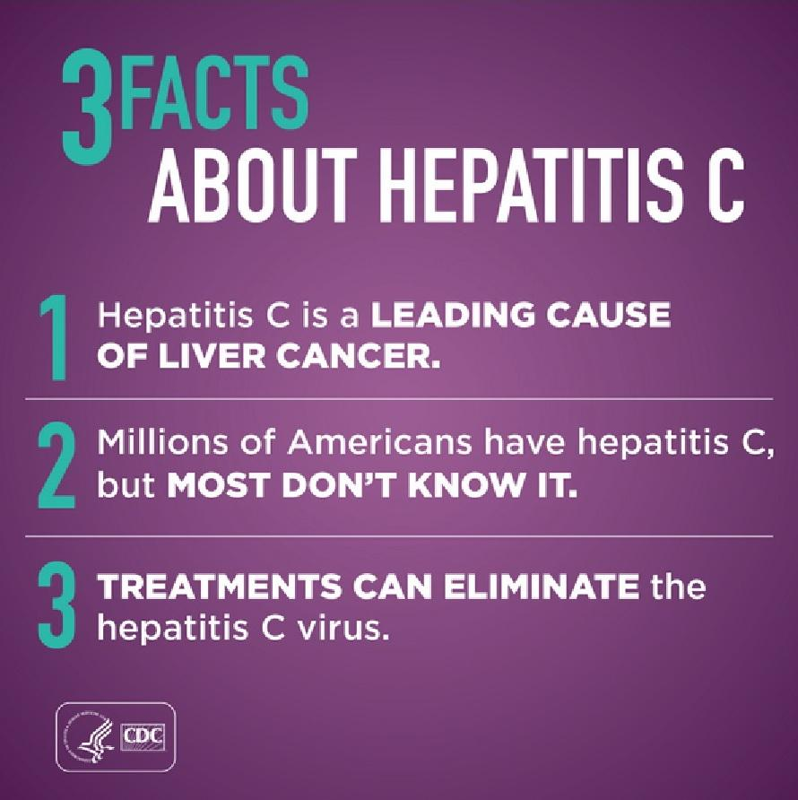
Motivation
team casper
Notes:
Hepatitic C is a disease that primarily affects the liver. It is caused by the hepatitis C virus and it is an infectious disease.
Hepatitis C is a leading cause of liver cancer. There are treatments to eliminate hepatitis C, however, when you have hep c, you may not know it.

Slide 4
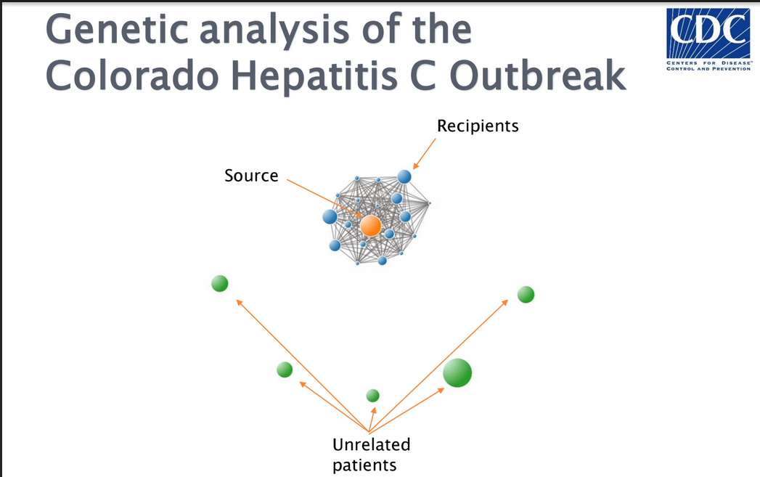
Motivation
team casper
Notes:
nodes = patient
links =

Slide 5
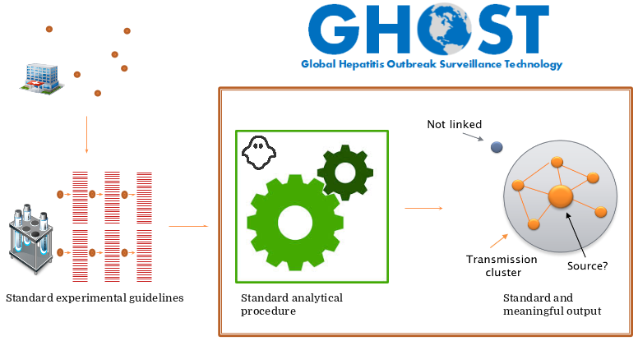
Current system (overview)
team casper

Slide 6
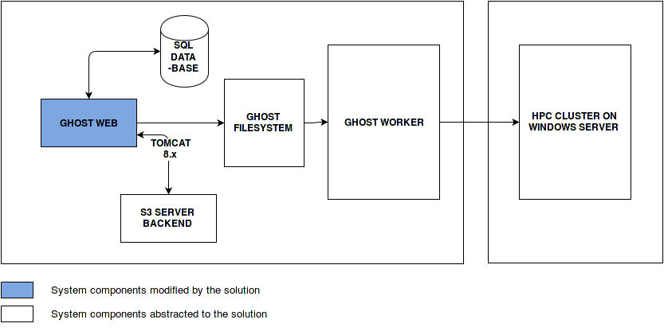
Current system (architecture)
team casper
Notes:
ghost gets data from SQL database
database server worker are analytical procedure.
filesystem: intermediate
ghost system has been focused on the back end of producing the node link representation from the raw data. However, the user interface of this project

Slide 7
Feasibility Report (Alternatives, criteria)
team casper
Alternatives
D3 (JavaScript) vs Flare (Flash)
Criteria
Rendering speed
Budget
Maintainability

Slide 8
Feasibility Report (Results)
team casper
 | D3.js (existing system) | Flare/Prefuse (new system)
Rendering speed | 60 fps (n<10) to 10 fps (n>1000) | Fully controllable at runtime
Loading Speed | Loads up to 3 times faster than Flare | Loads slowly (have to load a plugin)
Works with JSON? | Yes | Yes
Free & Open Source? | Yes | Yes
Development Support | StackOverflow comments: ~16k for D3, ~1k for NVD3 (a D3 add-on), ~962k for Javascript | StackOverflow comments: ~30 for Flare & Prefuse, ~47k for Actionscript

Slide 9
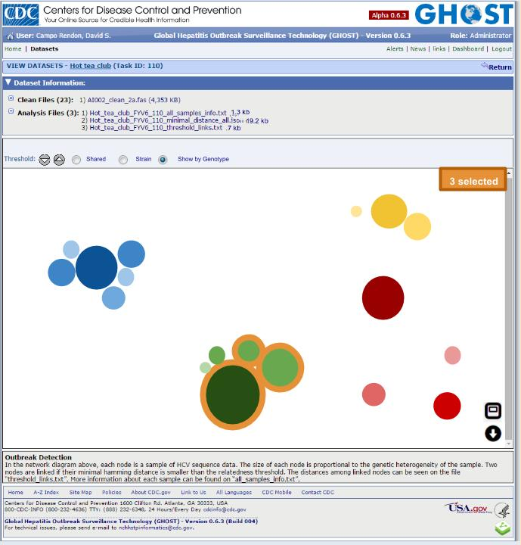
Statement of Work: Solution (Node Visualization)
team casper
Data Visualization
Threshold bar
Selection schema
Toggle mode
Download

Slide 10
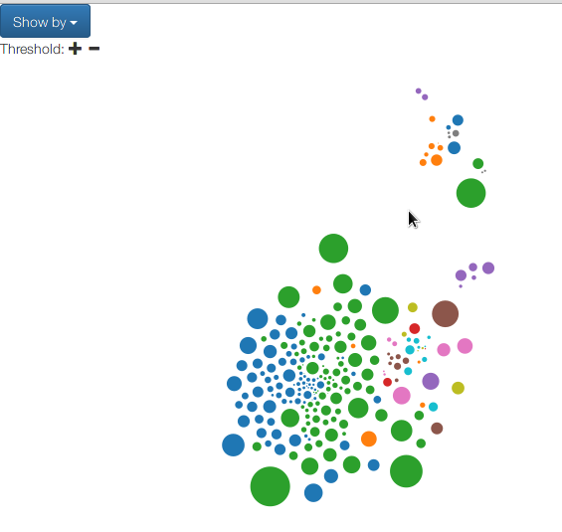
Node Visualization
team casper

Slide 11
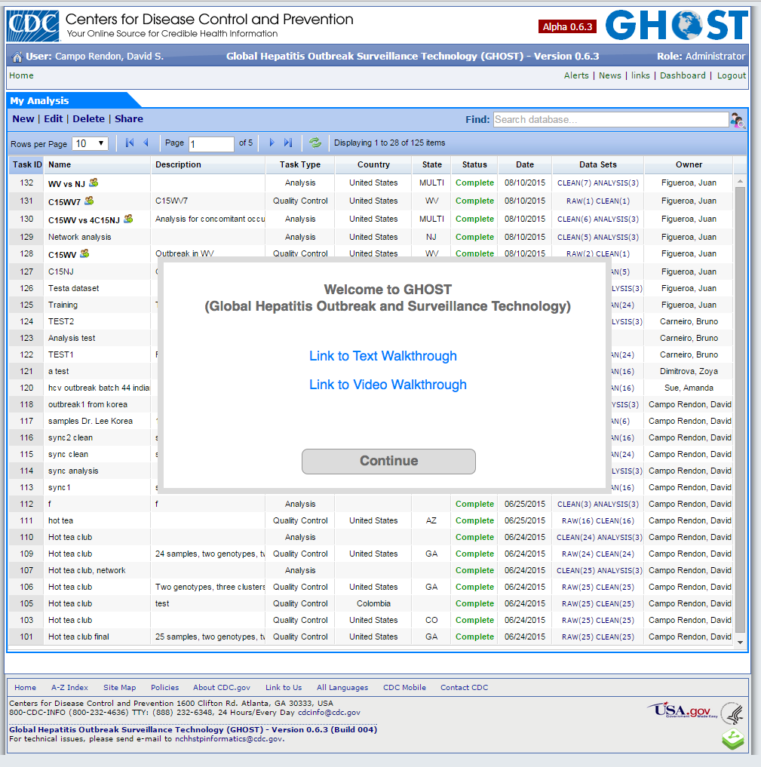
Statement of Work: Solution (Landing page)
team casper

Slide 12
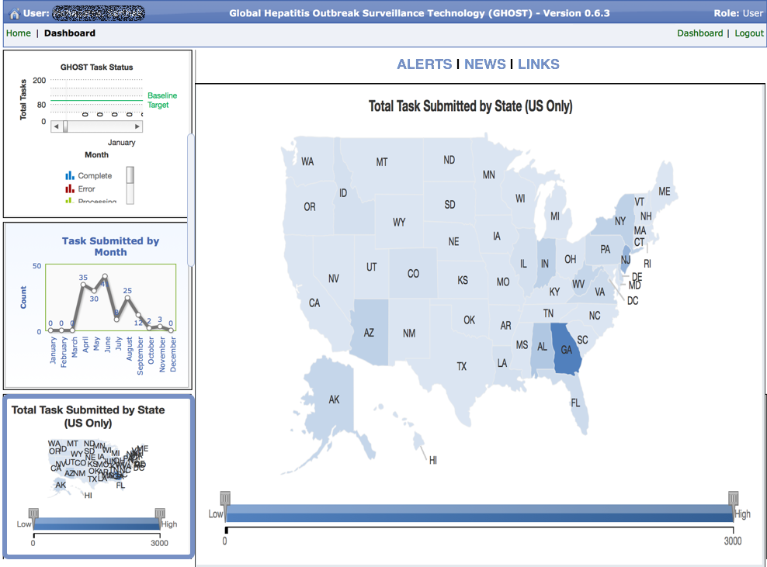
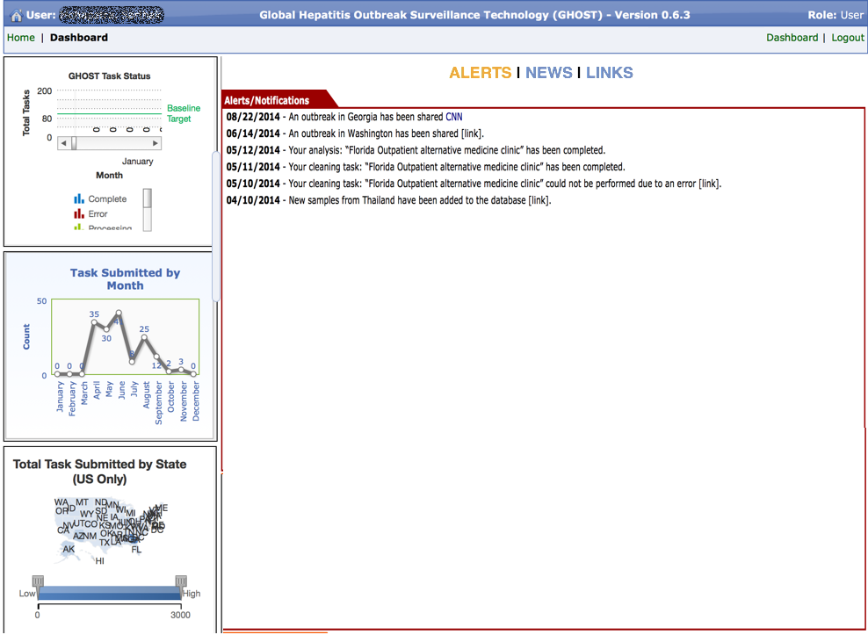
Statement of Work: Solution (Dashboard)
team casper

Slide 13
Statement of Work: Schedule
team casper
Releases
Node-link visualization
Landing page
Dashboard
Testing and documentation

Slide 14
Summary
team casper
GHOST is a system provided by the CDC for detections of Hepatitis C outbreaks
D3.js is the selected framework for its’ rendering speed and ease of maintainability
Landing page, visualizations, and dashboard components will be modified

Slide 15
Reflection
team casper
Learned
Formal documentation
Client communication
Improvement
For next semester

Slide 16
Reflection
team casper
Learned
Improvement
Earlier Prototyping
Aligned Expectations
For next semester

Slide 17
Reflection
team casper
Learned
Improvement
For next semester
Scheduling resolutions
Client communication

Slide 18
Questions?

